Slide 1

CAPSTONE PROJECT REVIEW I STOCK MARKET PREDICTION USING MACHINE LEARNING
Name : Arnab Karmakar
Register No:19BAI1090
Programme & Specialization : B.Tech CSE specialisation in AI and ML
Guide Name:
Dr Anita X.

Slide 2
Outline
Introduction
Abstract
Background
Literature Review
Research Gap -
Problem Statement
Research Motivation
Research Challenges
Research Objective
What is to be done next
Guide Approval mail snapshot
References

Slide 3
INTRODUCTION
1.1 INTRODUCTION
This section aims to provide a concise overview of the project, including the project's goals, challenges encountered, and report structure.
1.2 PROJECT OVERVIEW
Investment is a crucial part of finance. People/Companies invest in various assets to generate returns. Stocks are the most famous asset class for investment purposes. Returns are generated through capital appreciation or dividend payments in the stock market. However, stocks also carry a risk component, the price of the stock can go down resulting in losses. Thus, it is important to correctly select the stock that you will invest in, in order to generate a positive return.
In order to generate a positive return, one must be able to predict the price security should hold in the future and invest/choose not to invest in it based on its price. Analysts generally use Fundamental and/or Technical analysis to come to an intrinsic value for the stock.
AI is largely being adopted in the finance space. It is playing a major role in many important decisions making, models, investments, etc. This project aims to build an AI-based model that will help select stocks for investment purposes. We used seven machine learning and four deep learning algorithms. Since, the number of input data will gradually increase with respect to time will increase so neural network algorithms will perform better as accuracy of the neural network model increase with the increase in the input data.

Slide 4
The model should be able to predict stocks that are expected to appreciate in the near future. For correct prediction, we will be giving out promoter buying data combined with other attributes of the company. The rationale being a promoter is the best judge of the company and will not buy a substantial amount of stock if he doesn't expect it to do well in the future. The other attributes of the company are fed to increase the accuracy of the model. A corporate promoter is a firm or person who does the preliminary work related to the formation of a company, including its promotion, incorporation, and flotation, and solicits people to invest money in the company, usually when it is being formed. In most cases, the promoter is the founder and operator of the company. Therefore, a promoter is expected to have the best knowledge in terms of both company and the market.
1.3 PROJECT GOALS
The finalized project should be able to achieve the following purposes:
• Check if it is possible to create a successful portfolio with the promoter buying sheet.
• Create models that give buy/not buy decisions.
• Check how the model works in different time frames.
• Check if the portfolio gives alpha during the holding period.
• Check the impact of changing the return benchmark from zero on accuracy and portfolio return.

Slide 5
ABSTRACT
The financial exchange is one of the basic areas of a nation's economy. It permits financial backers to contribute and acquire profits from their venture. Foreseeing the securities exchange is an extremely difficult errand and has drawn in serious interest from specialists from many fields like measurements, man-made consciousness, financial matters, and money. An exact forecast of the financial exchange decreases speculation risk on the lookout. Various methodologies have been utilized to foresee the securities exchange. The exhibitions of Machine learning (ML) models are commonly better than those of measurable and econometric models. The brain network is one of the smart information mining procedures that has been involved by analysts in different regions for the beyond 10 years. Expectation and examination of financial exchange information play had a significant impact in the present economy. The different calculations utilized for gauging can be sorted into direct (AR, MA, ARIMA, ARMA) and non-straight models (ARCH, GARCH, Neural Network). Yet, this likewise intends that there's all's a ton of information to track down designs in. Thus, monetary investigators, specialists, and information researchers continue to investigate examination procedures to distinguish securities exchange patterns. This led to the idea of algorithmic exchanging, which utilizations computerized, pre-modified exchanging techniques to execute orders. I'll utilize both conventional quantitative money system and AI calculations to foresee stock developments. We'll go through the accompanying points:
Stock examination: major versus specialized investigation Stock costs as time-series information and related ideas Anticipating stock costs with Moving Average strategies Prologue to LSTMs
Foreseeing stock costs with a LSTM model Last considerations on new philosophies, like ES.

Slide 6
Background Work, Challenges
This section discusses the project’s design strategies. Deep learning, machine learning, web scraping, and data mining play a big role in this endeavor. The design aspect of the project is essential for retaining potential clients. This segment will explore artifacts as they relate to the technical design of an application and the user analysis of it. Various interactions with stock market specialists and researchers led to the creation of these design artifacts.
The data for the stock prediction was prepared by downloading datasets from the NSE website as well as scraping data from different websites using python programming. Then the datasets were merged and prepared according to our needs for the project.
The investor provides the information regarding the stock like stock id, the number of shares bought by the promoter, market cap, %age of the market cap, and a few others then the stock predictor analyzes that data on the basis of previous historical data and current stock information. After analyzing the data it predicts whether investing in the stock is going to be a “PROFIT” or “LOSS” for the investor.

Slide 7
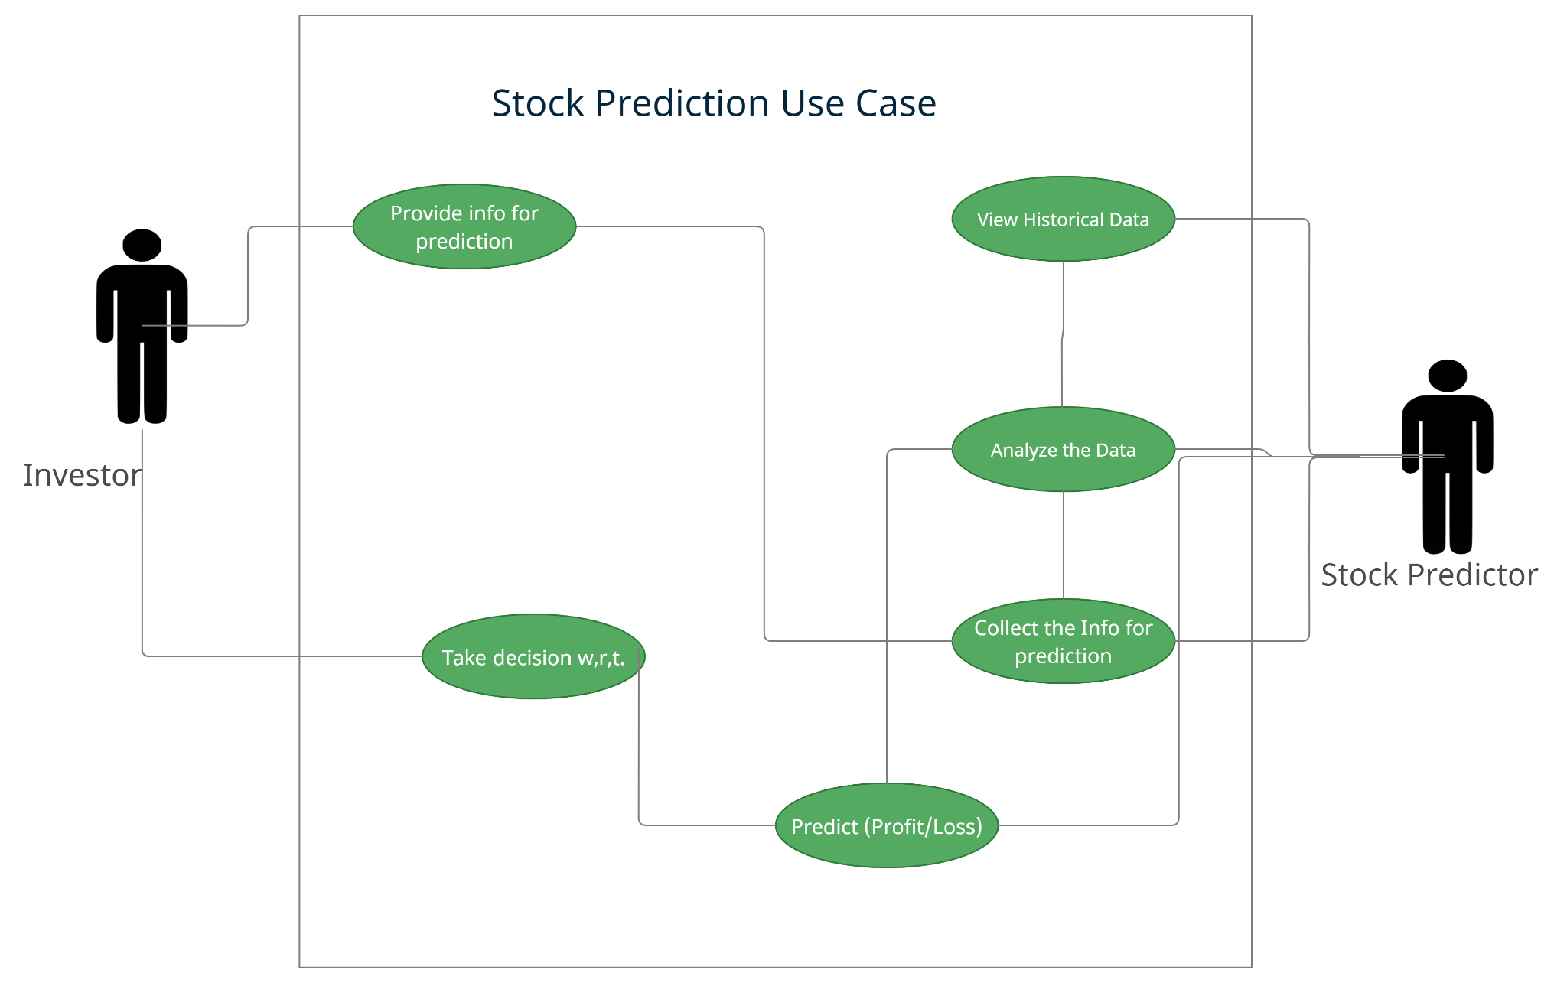
USE-CASE DIAGRAM

Slide 8
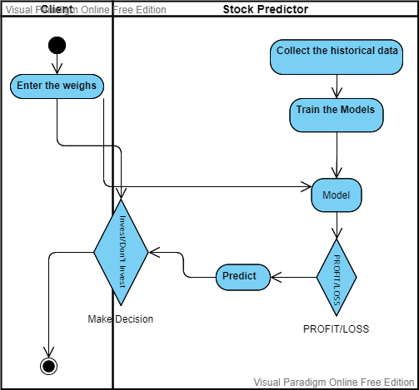
ACTIVITY DIAGRAM

Slide 9
LITERATURE SURVEY
RESEARCH OVERVIEW
This segment intends to provide information about the undertaken research related to the project. The chapter includes research from various sources about varied topics required to understand the project. This includes knowledge about stock prediction using insider data. This chapter will also talk about the technology used and the data prepared in building the project.
DATASET RESEARCH
Construction of models of machine learning and deep learning needs a heavy amount of data or datasets to build on efficiently. Before the beginning of any task of the project, the dataset must be thoroughly researched. The first of the tasks was to identify the datasets to further build data on. For the project, the main datasets that have been chosen are the last 6-year promoter buying dataset and then collected information regarding the stocks which will help in better prediction.

Slide 10
EXISTING TECHNOLOGY SOLUTIONS
In the following section a comprehensive review of the STOCK PREDICTION from the literature is done.
[1] Alan M. Safer has proposed the application of neural networks to predict abnormal stock returns using insider trading data. The research covered 343 companies over the period of 4 years. The research resulted in a few findings which are i) increasing the time of the future forecast the accuracy increases, ii) to increase the accuracy the time-period of back aggregated data should be increased. The paper mostly focused on a particular industry type thus focusing on a single industry type helped in better training of the algorithm. As well as the paper narrowed its assessment to small and mid-size companies rather than large ones.
[2] Kolasani S.V. and Assaf R. have proposed a system to predict stock movement with help of sentiment analysis using a Twitter feed with the help of a neural network. They attempted to forecast future stock market movement in the United States by assessing the emotion of market-related Twitter messages. Using the SVM algorithm, they gathered relevant tweets and calculated their average sentiment value. They then created a training set containing those tweets and the matching Apple Inc or DJIA closing stock index differential between today and tomorrow and tested it on comparable stock-related tweets on a separate timeline to see how well they could forecast the stock index. To forecast the stock index, they employed a Multilayer Perceptron Neural Network model and a Boosted Regression Tree model. It was discovered that tweets play an important part in the forecast of stock movement and that the Neural Network outperforms the Boosted Regression Tree in predicting too high and too low discrepancies in the stock index.

Slide 11
[3] Kohli P.P.S., Zargar S., Arora S., and Gupta P. tried to predict the behavior of the Bombay Stock Exchange (BSE) using machine learning algorithms. They used elements including commodity prices (crude oil, gold, silver), the foreign exchange rate (FEX), and market history to anticipate the behavior of the Bombay Stock Exchange as input attributes for multiple machine learning models (BSE). Because the correlation factor is the strongest, the data show that BSE is most dependent on the gold rate. Furthermore, the silver rate has the lowest correlation factor, indicating that BSE has the least reliance on it. The AdaBoost method has the greatest accuracy of 76.79 percent for 70 percent of training data and 75 percent for untrained data out of all the machine learning algorithms examined.
[4] Pang X., Zhou Y., Wang P., Lin W., and Chang V. tried to improve stock market forecasts, and for that, an innovative neural network technique was developed. Data was obtained live from the stock market for real-time and off-line analysis, as well as the results of visualizations and analyses, to demonstrate the Internet of Multimedia of Things for stock analysis. They used a deep long short-term memory neural network (LSTM) with an embedded layer and a long short-term memory neural network with an automatic encoder to anticipate the stock market. In the trials, the deep LSTM with an embedded layer performs better. The accuracy of the two models for the Shanghai A-shares composite index is 57.2 percent and 56.9 percent, respectively.

Slide 12
[5] Urmita Sharma, and Sumedha Seniaray proposed a deep learning-based model to make prediction more reliable and simpler. The LSTM technique, which is an advanced type of Recurrent Neural Network, was the focus of the article. They were able to predict the stock's closing price for the next 10 days after doing the experiment. They assessed the model's accuracy on 80 percent of the data that was already available and on 20 percent of the data that was not yet available. They also used an ADAM optimizer to improve it.
[6] Shen, J., Shafiq, M.O. Short-term stock market price trend prediction using a comprehensive deep learning system. J Big Data 7, 66 (2020). In the age of big data, deep learning is more popular than ever for predicting stock prices and trends. Collecting data for two years from him proposed extensive adjustments to the stock market in China's feature engineering and deep learning-based models to predict stock market price trends. Solution proposed is comprehensive, including stock exchange preprocessing dataset, using multiple feature engineering techniques in combination with customized a deep learning based system to identify stock price trends. predict. We conducted in-depth evaluation against commonly used machine learning models and concluded that the proposed solution excels due to the in-depth technical capabilities we have created. Overall, the system achieves high accuracy in stock market trend prediction. With a detailed design and evaluation of the length of the forecast period, engineering functions and data preprocessing methods, this work contributes to equity analysis research community in both financial and technical fields.

Slide 13
[7] M Umer Ghani, M Awais and Muhammad Muzammul Stock Market Prediction Using Machine Learning(ML)Algorithms Shares are in all likelihood the maximum famous monetary instrument invented for building wealth and are the centerpiece of any investment portfolio. The advances in buying and selling generation has spread out the markets so that nowadays nearly anyone can personal stocks. From previous few decades, there visible explosive growth inside the average individual’s interest for inventory marketplace. In a financially explosive market, because the stock marketplace, it's miles crucial to have a completely correct prediction of a destiny trend. due to the financial crisis and recording earnings, it's far compulsory to have a cozy prediction of the values of the stocks. Predicting a non-linear signal calls for progressive algorithms of gadget studying with assist of synthetic Intelligence (AI). In our research, we are going to use system gaining knowledge of algorithm in particular awareness on Linear Regression (LR), 3 month moving average(3MMA), Exponential Smoothing (ES) and Time series Forecasting the usage of MS Excel as fine statistical tool for graph and tabular representation of prediction outcomes. We received records from Yahoo Finance for Amazon (AMZN) stock, AAPL inventory and GOOGLE stock after implementation LR we efficiently expected inventory market trend for next month and also measured accuracy in step with measurements.
[8] Astelio Silvera Sarmiento, Darwin Daniel Ordoñez-Iturralde, Johanna Maribel Ochoa-Herrera, Jorge Armandodela Hoz Hernandez ,Ana Maria Echeverria
A documentary assessment changed into finished on the manufacturing and booklet of studies papers related to the observe of system gaining knowledge of strategies and the stock market. The cause of the bibliometric evaluation proposed on this document is to recognize the primary traits of the volume of courses registered inside the Scopus database at some stage in the duration 2016 2021, figuring out a total of 576 guides. The facts supplied by using the said platform become organized thru tables and figures, categorizing the information by using 12 months of publication, us of a of beginning, area of expertise and form of guide. as soon as these traits have been defined, the placement of different authors concerning the proposed topic became referenced through employing a qualitative evaluation. a number of the essential findings of this research, it's miles observed that India, with 209 publications, changed into the USA with the best medical manufacturing registered in the call of authors affiliated with institutions of t hat united states of America. The knowledge place that made the best contribution to the construction of bibliographic cloth regarding the have a look at of system gaining knowledge of strategies for stock market prediction become pc technological know-how with 459 posted files, and the type of publication that changed into maximum used in the course of the aforementioned period turned into the conference Article, representing 50% of the total clinical production.

Slide 14
[9] Lei in exploited Wavelet Neural Network (WNN) to predict stock price trends. The author also applied Rough Set (RS) for attribute reduction as an optimization. Rough Set was utilized to reduce the stock price trend feature dimensions. It was also used to determine the structure of the Wavelet Neural Network. The dataset of this work consists of five well-known stock market indices, i.e., (1) SSE Composite Index (China), (2) CSI 300 Index (China), (3) All Ordinaries Index (Australian), (4) Nikkei 225 Index (Japan), and (5) Dow Jones Index (USA). Evaluation of the model was based on different stock market indices, and the result was convincing with generality. By using Rough Set for optimizing the feature dimension before processing reduces the computational complexity. However, the author only stressed the parameter adjustment in the discussion part but did not specify the weakness of the model itself. Meanwhile, we also found that the evaluations were performed on indices, the same model may not have the same performance if applied on a specific stock.
[10] Sirignano and Cont leveraged a deep learning solution trained on a universal feature set of financial markets in. The dataset used included buy and sell records of all transactions, and cancellations of orders for approximately 1000 NASDAQ stocks through the order book of the stock exchange. The NN consists of three layers with LSTM units and a feed-forward layer with rectified linear units (ReLUs) at last, with stochastic gradient descent (SGD) algorithm as an optimization. Their universal model was able to generalize and cover the stocks other than the ones in the training data. Though they mentioned the advantages of a universal model, the training cost was still expensive. Meanwhile, due to the inexplicit programming of the deep learning algorithm, it is unclear that if there are useless features contaminated when feeding the data into the model. Authors found out that it would have been better if they performed feature selection part before training the model and found it as an effective way to reduce the computational complexity.

Slide 15
Research Gap
Models are an attempt to replicate real-life situations in numbers and try to predict the future. Thus models can't be correct but can come closer and closer to being correct. This can be done by working on improving the model, training it regularly, and researching new insights.
The benchmark used to predict the returns can be twisted to come up with the best suitable benchmark for each time period. The goal should not be to increase the accuracy of the model but to increase the returns of the model.
We should find other attributes of stock that have a positive correlation with profits when there is a promoter buying in the stock.
Currently, the results are calculated by the price of stocks on the first trading day of the buying month and 1st trading day of the selling month. The results can be enhanced by including technical analysis in deciding when to enter and exit a trade. This will give a possibility to buy at lower prices and sell at higher prices and thus increase return. This can also increase the accuracy of the model as the training of the model will be more precise.

Slide 16
PROBLEM STATEMENT
This part examines the difficulties that were experienced in finishing this undertaking. Every issue is momentarily depicted and examined exhaustively in resulting areas of the review. The most importantly challenge was removing and dealing with the authentic information of insider exchanging. The verifiable information ought to be adequately sufficiently enormous to prepare the model and back test the model for its exactness.
Dealing with the information included separating the information to just incorporate important information, and amalgamating the different exchanges organization wise in the month-to-month time period to make the information fit for preparing. This was accomplished utilizing Excel capabilities like channel and turn table.
We likewise needed to remove the authentic qualities of organizations that were pertinent at the hour of purchasing. It was hard to scrap information through various locales particularly stock-related destinations as there is a lot of futile data accessible, picking the one you really want is truly troublesome. Finding the locales which contain the data you want is another difficult assignment. When we had the sifted advertiser purchasing information and properties of the organization, we expected to settle on the design of the model. The construction that should have been made depended on monetary hypothesis. We needed to settle on questions like what time periods ought to be incorporated, should there be a benchmark rate, and if indeed, what ought to be the benchmark rate for various time spans?

Slide 17
Research Motivation
Stock prices can have unexpected moves because of a single news which keeps a stock artificially high or low. Hence, investors cannot predict what will happen with a stock on a day-to-day basis. This is called market sentiment factors and they include company news, economy, and world events.
Global economy. The flow of money and transactions is based on the economy of the traders which is affected by the economy of the country.
Stock historical prices. Each stock has a range which tick data moves within, when looking into chart patterns and behavior of investors.
Public sentiments and social media. A tweet from a president or an article release affects the price of the related stock(s). For example, an unofficial resignation of a CEO on twitter.
Natural disasters. For example, the “haiti earthquake” that killed around 316,000 people affected the S&P index by going down 6.6% after 18 trading days.
Earnings per share (EPS) is a fundamental factor that affects stock price. Investors tend to purchase stocks with high EPS since they know that they will gain substantial profits. The demand on this stock, the company management, the market sector dominance and the cyclical industry performance result in the movement of the stock price.
Inflation and deflation are technical factors. Inflation means higher buy price and thus higher interest rates. This will result in a decrease of stock price. On the contrary, deflation means lower buy prices and thus lower profits and interest rate.

Slide 18
PROJECT CHALLENGES
This section discusses the challenges that were encountered in completing this project.
Each problem is briefly described and discussed in detail in subsequent sections of the study.
The first and foremost challenge was extracting and managing the historical data of insider trading. The historical data should be sufficiently large enough to train the model and back test the model for its accuracy. Managing the data included filtering the data to only include relevant data, and amalgamating the various transactions company-wise in the monthly time frame to make the data fit for training. This was achieved using Excel functions like filter and pivot table.
We also had to extract the historical attributes of companies that were relevant at the time of buying. It was difficult to scrap data through different sites especially stock-related sites as there is too much useless information available, picking the one you need is really difficult. Finding the sites which contain the information you need is another challenging task.
Once we had the filtered promoter buying data and attributes of the company, we needed to decide on the structure of the model. The structure that needed to be created was based on financial theory. We had to decide on questions like what timeframes should be included, Should there be a benchmark rate, and If yes, what should be the benchmark rate for different time periods.

Slide 19
Research objectives
Stock markets help companies to raise capital.
It helps generate personal wealth.
Stock markets serve as an indicator of the state of the economy.
It is a widely used source for people to invest money in companies with high growth potential.

Slide 20
Work to be Completed
Construction of analysis material
The information identified in the previous phase is organized. The classification will be made through graphs, figures and tables based on data provided by Scopus.
Word Co-occurrence
Country of origin of the publication.
Area of knowledge.
Drafting of conclusions and final document
After the analysis carried out in the previous phase, the conclusions are drawn up and the final document is prepared.

Slide 21
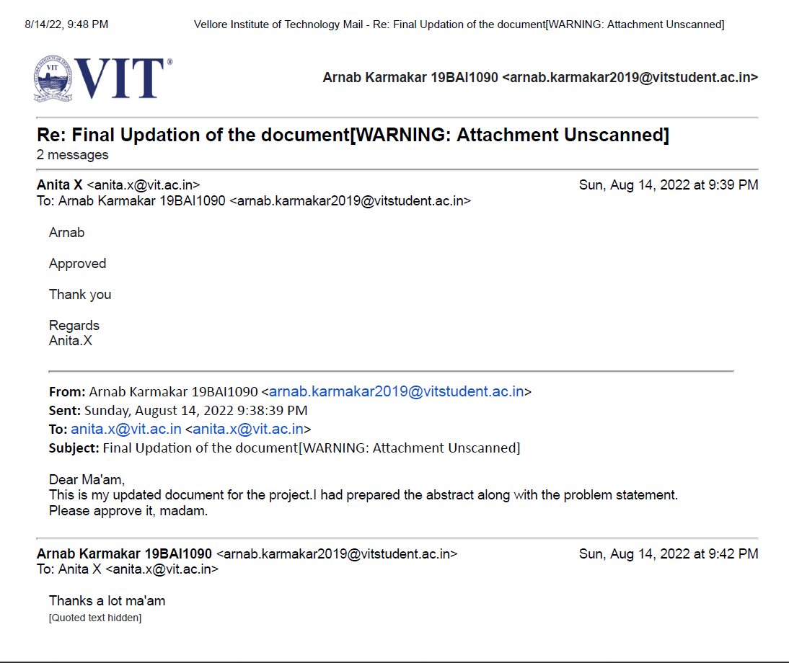
Guide Approval Snapshot

Slide 22
References
Naik, N., Mohan, B.R. Intraday Stock Prediction Based on Deep Neural Network. Natl. Acad. Sci. Lett. 43, 241–246 (2020).
Pang, X., Zhou, Y., Wang, P. et al. An innovative neural network approach for stock market prediction. J Supercomput 76, 2098–2118 (2020).
Kohli P.P.S., Zargar S., Arora S., Gupta P. (2019) Stock Prediction Using Machine Learning Algorithms. In: Malik H., Srivastava S., Sood Y., Ahmad A. (eds) Applications of Artificial Intelligence Techniques in Engineering. Advances in Intelligent Systems and Computing, vol 698. Springer, Singapore.
Ye, Q. and Wei, L. (2015) The Prediction of Stock Price Based on Improved Wavelet Neural Network. Open Journal of Applied Sciences, 5, 115-120.
Kolasani, S. and Assaf, R. (2020) Predicting Stock Movement Using Sentiment Analysis of Twitter Feed with Neural Networks. Journal of Data Analysis and Information Processing, 8, 309-319.
https://doi.org/10.1186/s40537-020-00333-6
Keras URL https://keras.io/
TensorFlow URL https://www.tensorflow.org/tutorials
Safer, A.M., The application of neural networks to predict abnormal stock returns using insider trading data. Applied Stochastic Models in Business and Industry, 18(4), pp.381-389.
Sadia, K.H., Sharma, A., Paul, A., Padhi, S. and Sanyal, S., 2019. Stock market prediction using machine learning algorithms. Int. J. Eng. Adv. Technol, 8(4), pp.25-31.
Deep Learning URL https://www.deeplearning.ai/
Kuhn, Max and Johnson, Kjell. Applied Predictive Modeling. Springer. 2013
Lakonishok, Josef, and Inmoo Lee, 2001, Are insider trades informative? Review of Financial Studies 14, 79-111.

Slide 23
Thank You

